Slide 1



Plastic Detection Using RF / Microwave Signals and Machine Learning
RECYCLING
RECYCLING

Slide 2

Introduction
Plastic pollution is a major environmental concern
Conventional detection methods are ineffective for plastic
Plastic is non-metallic and non-magnetic
RF and microwave signals interact with materials based on dielectric properties
Machine Learning enables intelligent material classification

Slide 3
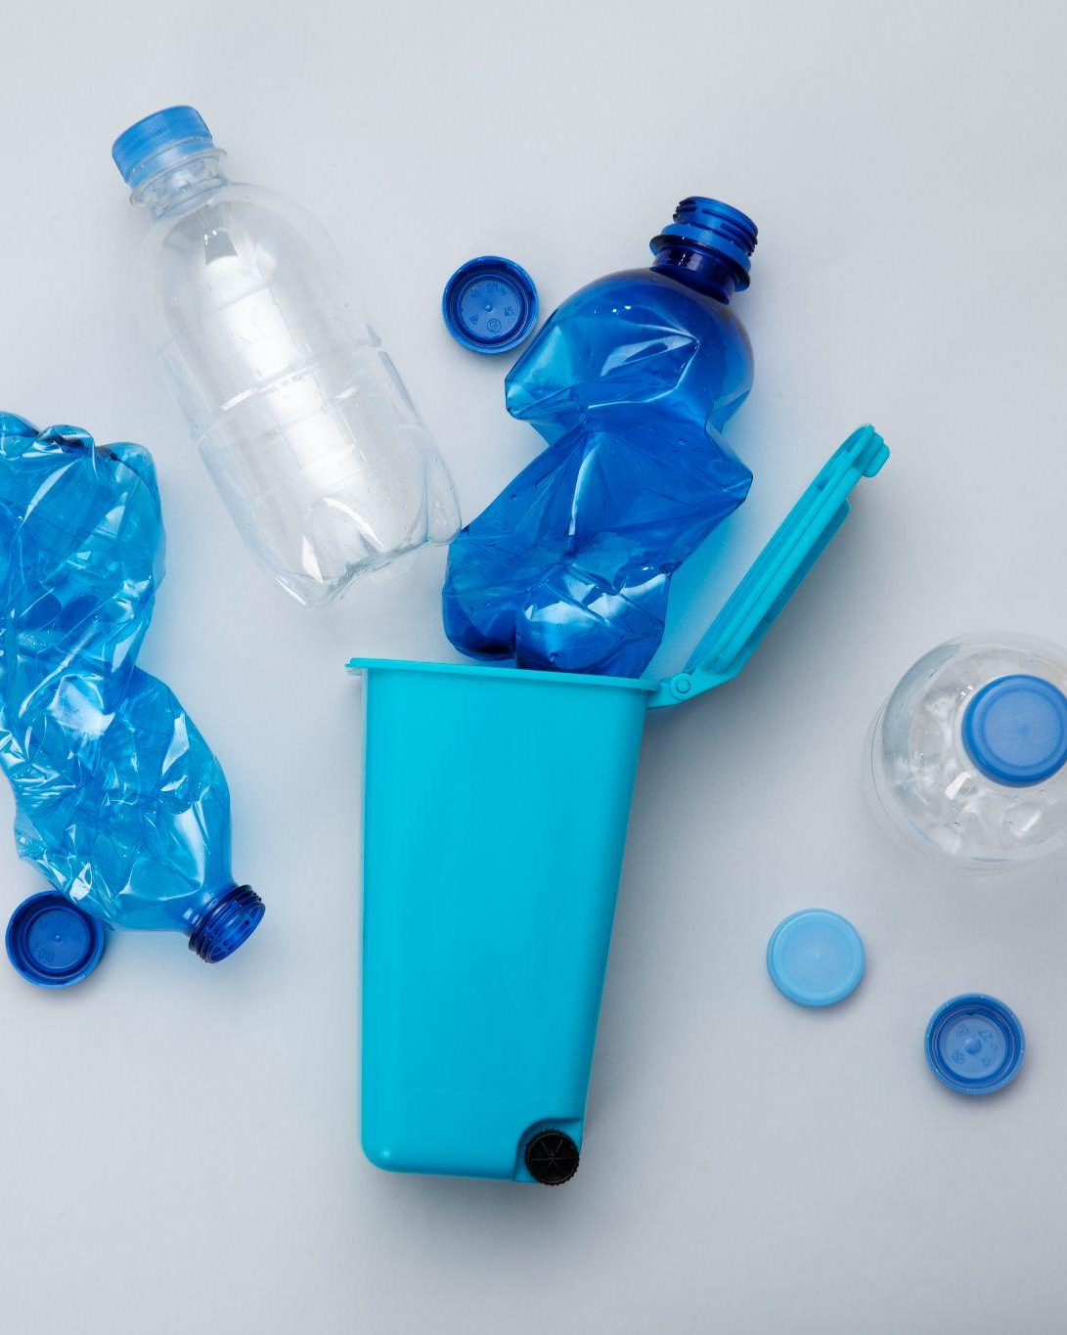
Problem Statement
Metal detectors cannot detect plastic materials
Optical methods fail in dusty or mixed-waste environments
Manual segregation is time-consuming and inaccurate
Need a non-contact, non-destructive, low-cost plastic detection system

Slide 4

Core Concept (RF + ML)
Plastic slightly changes signal strength, phase, and reflection patterns.
Changes are subtle → need ML to classify patterns.
RF/Microwave principle
ML principle
Learn from labeled examples
Detect plastic among multiple materials

Slide 5
RF senses the material, ML decides the material type

Slide 6
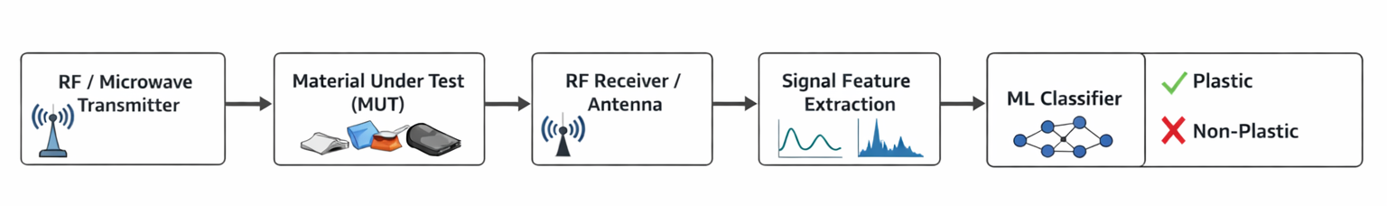
System Architecture
Features extracted:
RSSI (Received Signal Strength Indicator)
Phase shift
Signal variance
FFT / frequency domain features

Slide 7
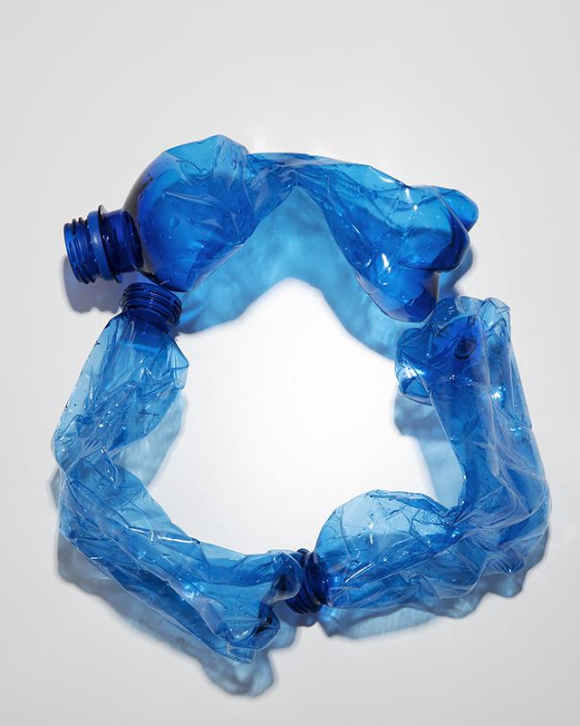
Data Collection
Collect multiple samples:
plastic, glass, paper, metal, wood
Record signal variations:
Distances (10–50 cm)
Thicknesses (1–5 mm)
Orientation angles
Label dataset: Plastic = 1, Others = 0
Typical dataset:
500–1000 readings per material

Slide 8
Common Types of Plastics
Type | Full Name | Dielectric Property | Common Uses
PET | Polyethylene Terephthalate | εr ≈ 3.0 – 4.0 | Bottles, food containers
HDPE | High-Density Polyethylene | εr ≈ 2.3 – 2.5 | Milk jugs, detergent bottles
PVC | Polyvinyl Chloride | εr ≈ 3.0 – 3.5 | Pipes, cables, window frames
LDPE | Low-Density Polyethylene | εr ≈ 2.2 – 2.3 | Plastic bags, films
PP | Polypropylene | εr ≈ 2.1 – 2.3 | Caps, straws, food containers
PS | Polystyrene | εr ≈ 2.5 – 2.6 | Disposable cups, packaging
PC | Polycarbonate | εr ≈ 2.9 – 3.0 | CDs, water bottles, eyeglasses

Slide 9
Common Types of Plastics
Material | εr | RSSI | Label
PET | 3.2 | -61 | 0
HDPE | 2.4 | -58 | 1
PP | 2.2 | -59 | 2
PVC | 3.3 | -60 | 3
Material | εr | RSSI | Label
PET | 3.2 | -61 | 0
HDPE | 2.4 | -58 | 1

Slide 10
Hardware Components
Transmitter | ESP32 Wi-Fi / RF module (2.4 GHz)
Receiver | RF antenna / ESP32 RSSI readings
Processing | PC for ML training/testing
Actuator | Relay or conveyor for plastic separation

Slide 11
Software Tools
01
02
03
Python
Scikit-learn
For ML model and data preprocessing
SVM, Random Forest
Arduino IDE
You can describe the topic of the section hereHardware interfacing

Slide 12
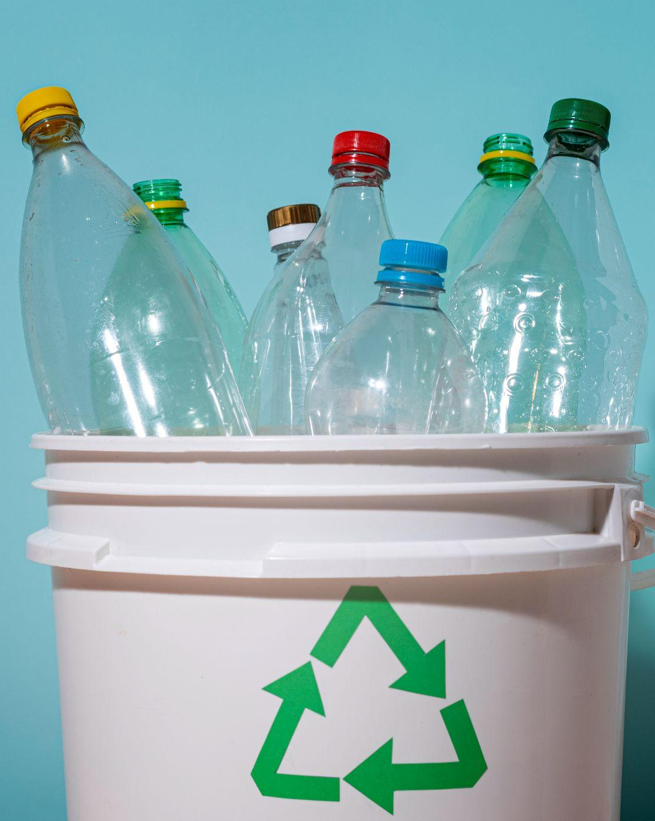
Applications
Recycling plants for automatic plastic sorting
Food & packaging industry for material verification
Environmental monitoring of plastic pollution
Smart conveyor belts in industrial automation
Waste management systems

Slide 13
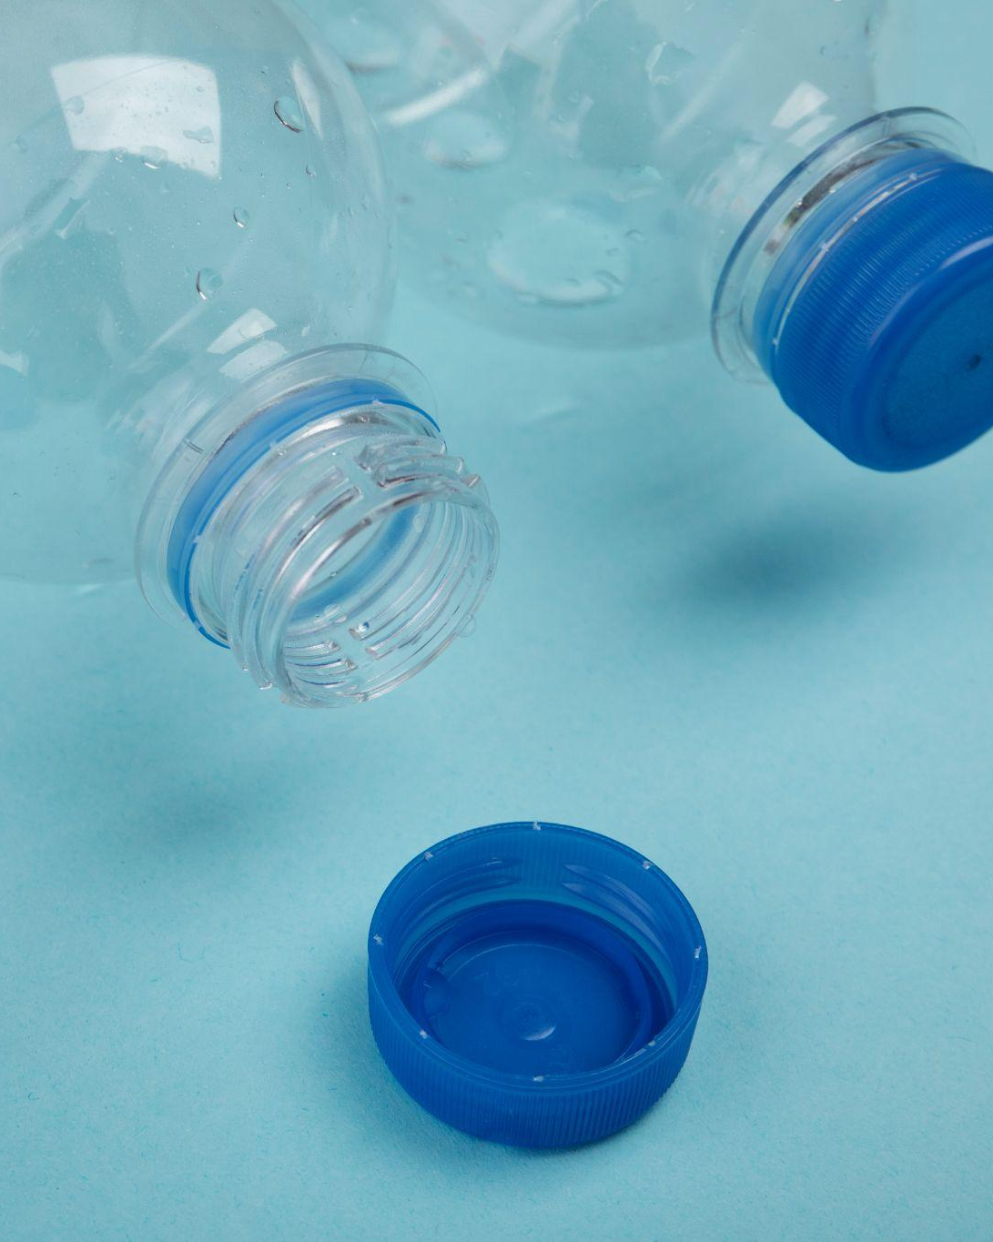
Advantages
Non-contact and non-destructive detection
Works in harsh environments (dusty, dirty, low light)
Real-time detection possible
Low-cost (ESP32 based)
Scalable to industrial applications

Slide 14
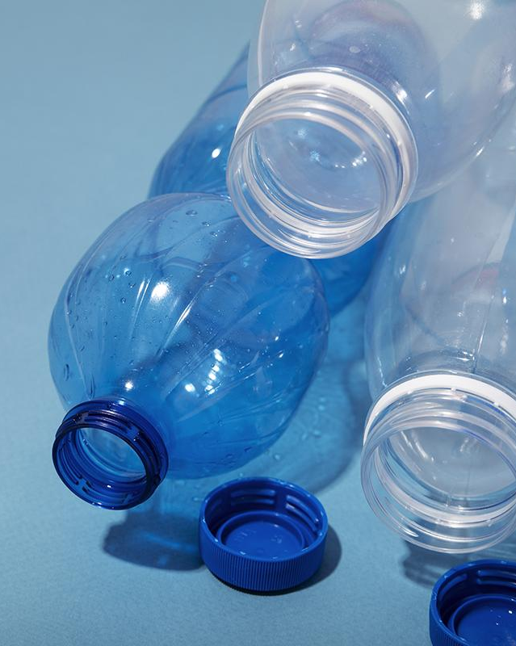
Conclusion
RF + ML enables reliable plastic detection
System is efficient, accurate, and low-cost
Can be integrated into industrial sorting systems
Offers potential for smart waste management solutions

Slide 15
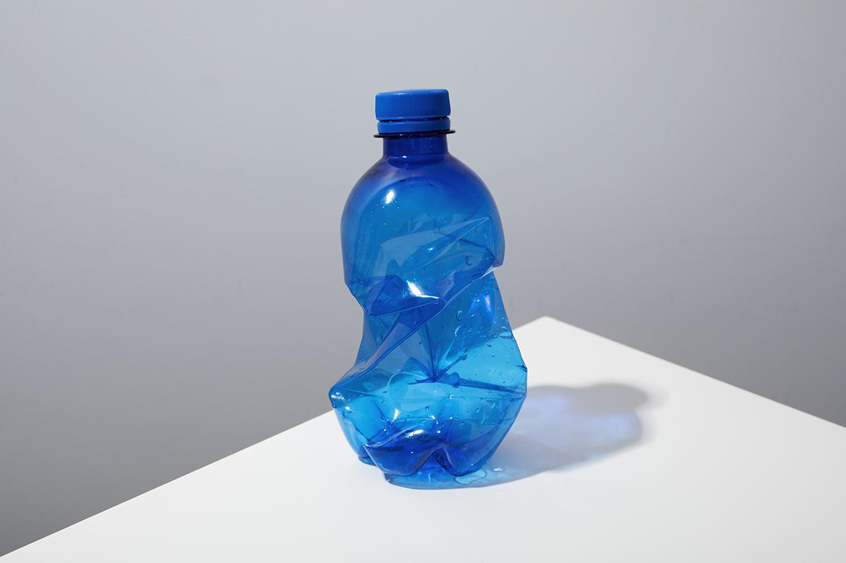
THANK YOU

